Slide 1

The FAST Act and NEPA
2017 ACEC-KY/FHWA/KYTC Partnering Conference
Cory Grayburn
August 16, 2017

Slide 2
Agenda
I-69 Ohio River Crossing Project (I-69 ORX)
FAST Act, NEPA, and the I-69 ORX Project
Summary

Slide 3
I-69 Ohio River Crossing Project

Slide 4

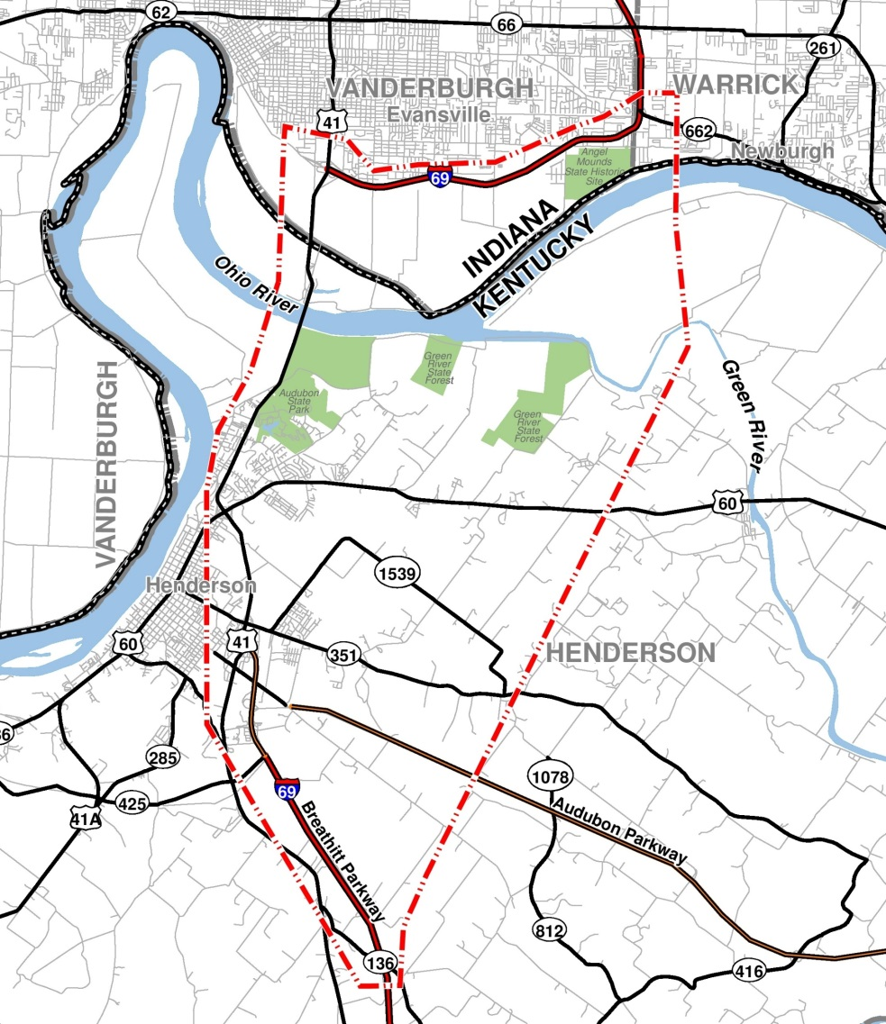
I-69 Ohio River Crossing Project
Part of the National I-69 Corridor connecting Mexico and Canada.
Designated as Section of Independent Utility #4.
DEIS completed in 2004 but the project was suspended in 2005. Identified a Preferred Alternative.
KYTC 2014 I-69 Feasibility Study.
June 30, 2016 – Governors Pence of Indiana and Bevin of Kentucky sign MOU recommitting to the project.
February 13, 2017 – Revised Notice of Intent.
Logical termini were modified based on the re-designation of I-164 (Indiana) and Breathitt Parkway (Kentucky) as I-69.

Slide 5
I-69 Ohio River Crossing Project
Project Purpose
Provide cross-river system linkage and connectivity between I‑69 in Indiana and I‑69 in Kentucky that is compatible with the National I‑69 Corridor.
Develop a solution to address long-term cross-river mobility.
Provide a cross-river connection that reduces traffic congestion and delay.
Improve safety for cross-river traffic.

Slide 6
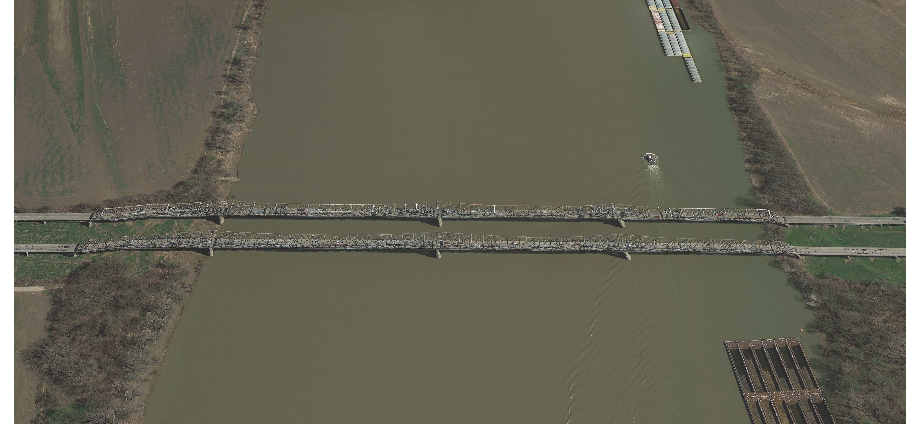
US 41 Bridges

Slide 7
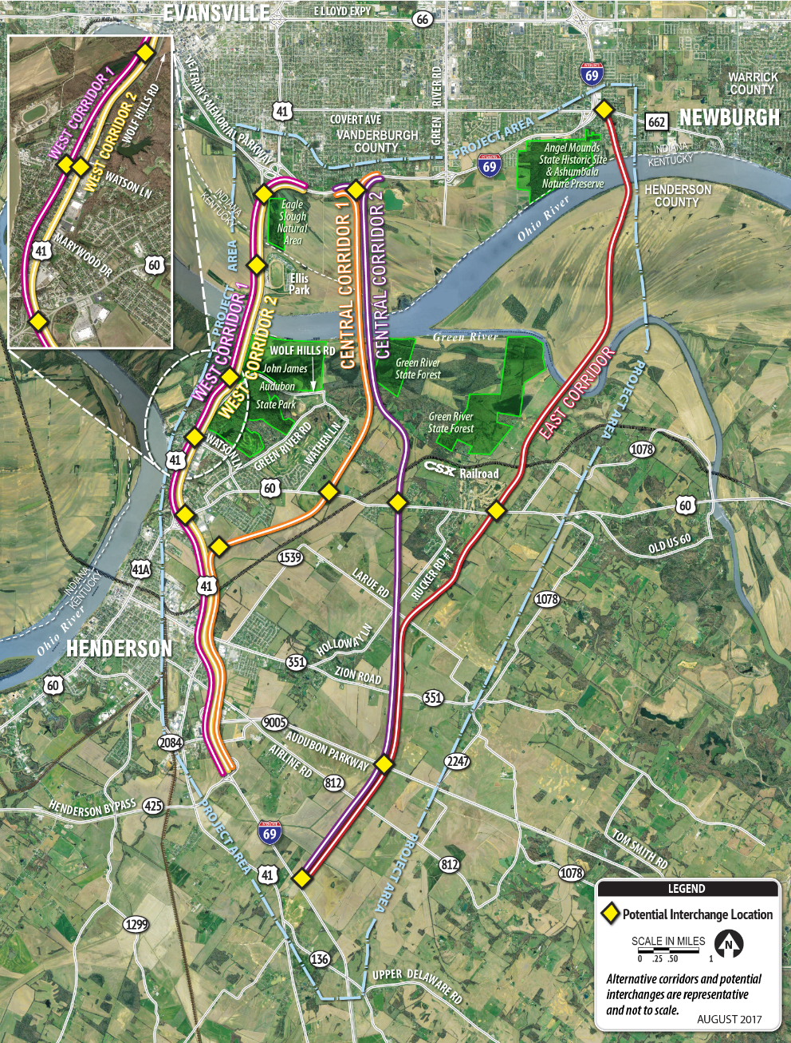
I-69 Ohio River Crossing Project
Range of Alternatives
No Build
West Corridor 1
West Corridor 2
Central Corridor 1
Central Corridor 2 (2004 DEIS Preferred Alternative)
East Corridor

Slide 8
I-69 Ohio River Crossing Project
Public and Agency Coordination
Project Offices in Evansville and Henderson
Public Open Houses
Committees
River Cities Advisory Committee (RCAC)
Environmental Justice Subcommittee
Interagency Advisory Committee (IAC)
Elected Officials Meetings
Stakeholder Group Meetings
Section 106 Consulting Parties
Project website, Twitter, and Facebook

Slide 9
I-69 Ohio River Crossing Project
Major Issues
Socioeconomic impacts to the City of Henderson
Forested wetlands
Threatened and endangered species such as mussels, Indiana bat, and northern long-eared bat
Avoiding John James Audubon State Park, Green River State Forest, Angel Mounds State Historic Site, and Eagle Slough Natural Area
Major bridge design over the Ohio River
Tolling
Environmental Justice
US 41 bridges (Northbound bridge is listed on the National Register of Historic Places as eligible and the southbound bridge will likely be deemed eligible.)

Slide 10
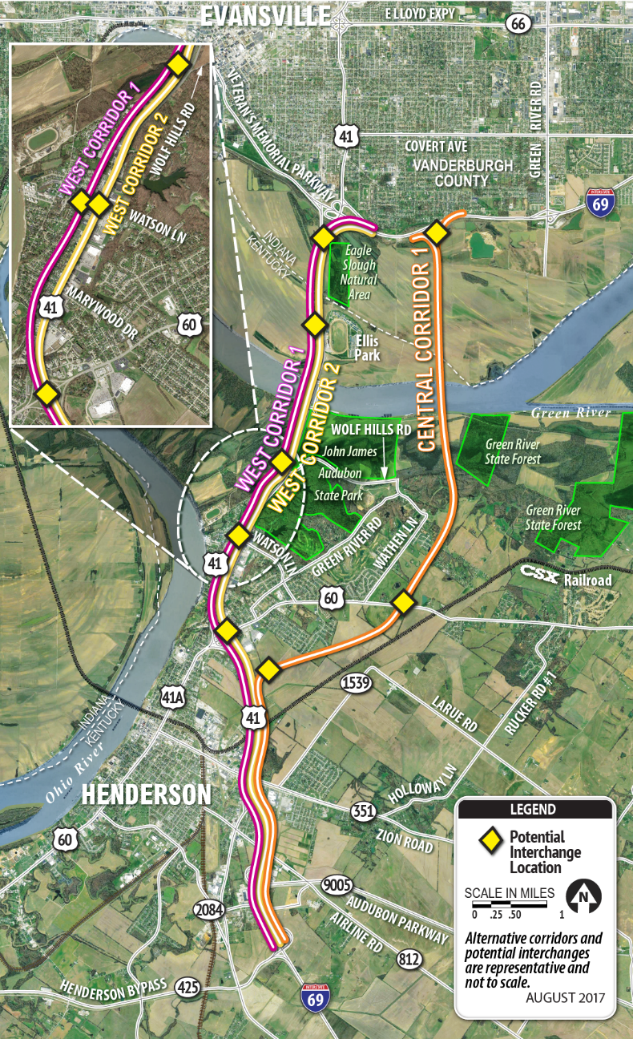
I-69 Ohio River Crossing Project
Screening Report – Corridors Recommended for Further Development
No Build
West Corridor 1
West Corridor 2
Central Corridor 1
Tolling Options
Toll the new I-69 bridge
Toll both the new I-69 bridge and existing US 41 bridges
Different tolling rates based on bridge location and vehicle class
US 41 Options
Keep both US 41 bridges open
Close one or both US 41 bridges
Improvements along US 41

Slide 11
Project Timeline
Summer 2017 to Summer 2018
Preliminary Engineering
Detailed Field Surveys
DEIS Preparation
Fall 2018 – DEIS Publication/Public Hearing/45-day Comment Period
Fall 2019 – FEIS/ROD Publication

Slide 12
The FAST ACT, NEPA, and I-69 ORX Project

Slide 13
Federal Transportation Bills
Intermodal Surface Transportation Efficiency Act (ISTEA) – 1991
Transportation Equity Act of the 21st Century (TEA-21) – 1998
Safe, Accountable, Flexible, Efficient Transportation Equity Act: A Legacy for Users (SAFETEA-LU) – 2005
Moving Ahead for Progress in the 21st Century Act (MAP-21) - 2012
Fixing America’s Surface Transportation Act (FAST Act) – December 4, 2015
Amendments to Title 23 – Highways, United States Code
Provides funding for transportation projects and guidance on public and agency coordination and NEPA documentation.

Slide 14
FAST Act
Section 1304 - Efficient Environmental Review for Project Decisionmaking
Lead Agency/Project Coordination
Identify participating agencies no later than 45 days after the notice of intent (NOI).
Establish a coordination plan no later than 90 days after the NOI.
Develop a checklist in consultation with participating agencies to identify natural, cultural and historic resources in the project area.
Develop an environmental document sufficient to satisfy the requirements for any Federal approval, action, or permit required for the project.
All Federal permits and reviews shall rely on a single NEPA document.

Slide 15
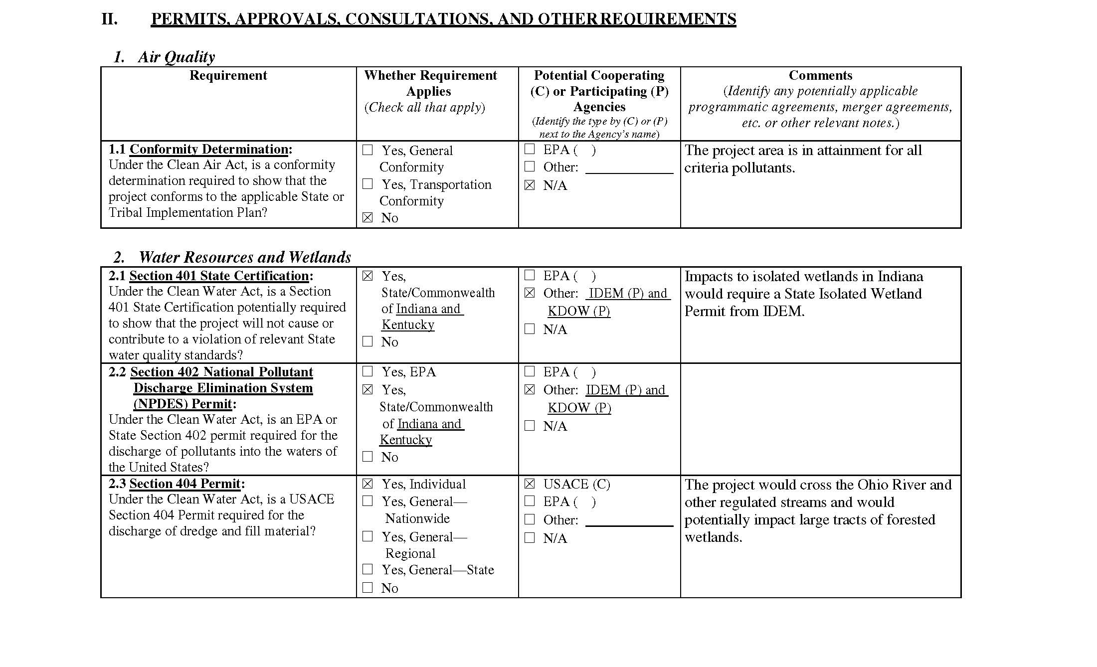
Checklist

Slide 16
FAST Act
Section 1304 - Efficient Environmental Review for Project Decisionmaking
Alternatives Analysis
Participating agencies shall limit their comments to their area of special expertise or jurisdiction.
Participating agencies that decline participation in development of purpose and need and range of alternatives must comply with schedule for the project.
The lead agency may eliminate alternatives that have been considered in the metropolitan planning process or a State environmental review process.
Issue Identification and Resolution
Any issue resolved by the lead agency with concurrence of participating agencies may not be reconsidered unless significant new information or circumstances arise.

Slide 17
FAST Act
Section 1304 - Efficient Environmental Review for Project Decisionmaking
Accelerated Decision Making in Environmental Reviews
Reemphasizes the use of errata sheets for the DEIS instead of rewriting the DEIS and the preparation of a single document that consists of the FEIS and ROD.
Improving Transparency in Environmental Reviews
Federal agencies must use a “searchable internet website” (i.e., Permitting Dashboard) to provide information to the public on the status and progress of EAs, EISs, and permitting.
Programmatic Approaches to Conduct Environmental Reviews
Secretary shall ensure that programmatic reviews:
promote transparency;
use accurate and timely information;
are available to other relevant Federal and State agencies, Indian tribes, and the public; and
provide notice and public comment opportunities

Slide 18
FAST Act, NEPA, and the I-69 ORX Project - Summary
Provides specific deadlines for identifying participating agencies and preparing the coordination plan.
Includes the addition of a checklist.
Promoted the use of a single NEPA document that would satisfy the requirements for any Federal approval, action, or permit for the project.
Participating agencies are limited to commenting only on their area of expertise/jurisdiction, must comply with the project schedule if they decline participation in the development of the purpose and need and range of alternatives, and may not reconsider issues that they have provided concurrence.
The lead agency may eliminate alternatives that have been considered in the metropolitan planning process or a State environmental review process.
Reemphasizes the use of errata sheets for the DEIS and a single FEIS/ROD document.
Promotes transparency in the environmental review process by providing project information on a searchable internet website.

Slide 19
Questions?

